Slide 1
OOSDLC
SYSTEM Development Methodology: Any logical process used by a System Analyst or Business Analyst to develop an Information System.
The methodology results in a high quality system that: meets or exceeds customer expectations • within time and cost estimates • works effectively and efficiently in the current and planned Information Technology infrastructure • cheap to maintain and cost-effective to enhance
Different methodologies place emphasis on different aspects of the system development process.

Slide 2
RUP
An engineering process that provides a disciplined approach to assigning and managing tasks and responsibilities to developing software systems.
An object-oriented systems development methodology.
Uses UML for visual notation

Slide 3
OOSDLC
OO SDLC consists of following macro phases.
Conceptualization
Object oriented analysis
Object oriented design
Object oriented implementation (programming)
Maintenance
Conceptualization
-To establish the vision and core requirements of the software system to be developed

Slide 4
Object oriented analysis
To build models of the system’s desired behavior, using notations such as the Unified Modeling Language (UML)
To capture the essential relevant aspects of the real world and to define the services to be provided and/or the problems to be solved.
To simplify reality to better understand the system to be developed
During object-oriented analysis, the focus is on finding and describing objects or concepts in the problem domain. For example, in the case of library management system, some of the concepts are Book, Library and Librarian.
In the phase of OOA the typical question starts with What...? like “What will my program need to do?”, “What will the classes in my program be?” and “What will each class be responsible for?” . Hence, OOA cares about the real world and how to model this real world without getting into much detail.
Larman describes in [Lar02] the OOA phase as an investigation of the problem and requirements, rather than finding a solution to the problem

Slide 5
Object oriented design
Design emphasizes a conceptual solution (in software and hardware) that fulfills the requirements, rather than its implementation.
For example, a description of a database schema and software objects.
OOD phase, the question typically starts with How...? like “How will this class handle it’s responsibilities?”, “How to ensure that this class knows all the information it needs?” and “How will classes in the design communicate?” .
The OOD phase deals with finding a conceptual solution to the problem – it is about fulfilling the requirements, but not about implementing the solution
During object-oriented design, the focus is on defining software objects and how they collaborate to fulfill the requirements. For example, in the library system, a Book software object may have a title attribute and getChaptermethod.

Slide 6
Object oriented Programming
Bottom–up approach in program design
Programs organized around objects, grouped in classes
Focus on data with methods to operate upon object’s data
Interaction between objects through functions
Reusability of design through creation of new classes by adding features to existing classes

Slide 7
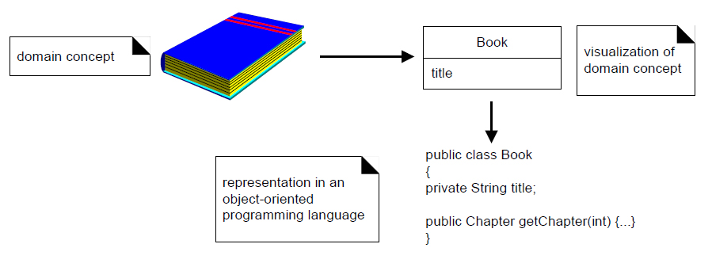
OOP
Finally, in Implementation or object-oriented programming, the design objects are implemented as classes like Book class in Java.

Slide 8
OOAD
OOA | OOD
OOA identify: | OOD decide how to implement:
Classes: who am I ? What do I contain? Who am I associated with? | Classes State
Attributes: what do I need to know? | Behavior
Behaviors: what can I do? | Collaborations
Collaborations: what help do I need ? Who needs my help? | Add implementation specific components: Human interactions
 | Data management

Slide 9
Steps/Activities for Object oriented Analysis
Analyze the domain problem
Describe the process of systems
Identify the objects
Specify attributes
Defining operations
Define and establish Inter-object Communication mechanism

Slide 10
objects
External Entity (e.g., other systems, devices, people) that produce or consume information to be used by system
Things (e.g., reports, displays, letters, signals) that are part of information domain for the problem
Places (e.g., book’s room) that establish the context of the problem and the overall function of the system.
Organizational units (e.g., division, group, team, department) that are relevant to an application
Transaction (e.g., loan, take course, buy, order)

Slide 11
Example of candidate objects
Just a Line management wishes to increase security, both in their building and on site, without antagonizing their employees. They would also like to prevent people who are not part of the company from using the Just a Line car park. It has been decide to issue identity cards to all employees, which they are expected to wear while on the Just a Line site. The cards records the name, department and number of the member of staff, and permit access to the Just a Line car park. A barrier and a card reader are placed at the entrance to the car park. The driver of an approaching car insert his or her numbered card in the card reader, which then checks that the card number is known to the Just a Line system. If the card is recognized, the reader sends a signal to raise the barrier and the car is able to enter the car park. At the exit, there is also a barrier, which is raised when a car wishes to leave the car park. When there are no spaces in the car park a sign at the entrance display “Full” and is only switched off when a car leaves. Special visitor’s cards, which record a number and the current date, also permit access to the car park. Visitor’s cards may be sent out in advance, or collected from reception. All visitor’s cards must be returned to reception when the visitor leaves Just a Line.

Slide 12
Candidate objects are:
Just a line management, security, building, site, employee, people, company, car park, cards, name, department, number, member of staff, access, barrier, card reader, entrance, driver, car, system, signal, exit, space, sign, visitor, reception

Slide 13
Candidate objects rejection rule
Duplicates: if two or more objects are simply different names for the same thing.
Irrelevant: objects which exists in the problem domain, but which are not intended.
Vague: when considering words carefully it sometimes becomes clear that they do not have a price meaning and cannot be the basis of a useful in the system.
General: the meaning is too broad.
Attributes: as the attribute of objects p
Associations: actually represents the relationships between objects.
Roles: sometimes objects referred to by the role they play in a particular part of the system.

Slide 14
Rejected candidate objects
Candidate objects | Rejection criteria
Just a line, member of staff | Duplicate with company and employee respect.
Management, company, building, site, visitor and reception | Irrelevant to the system
Security, people | vague
System | Too general
Name, department | Attribute
Access | Association
driver | role

Slide 15
Object oriented design
OOD transforms the analysis model created using OOA into a design model that serves as a blueprint for software construction
Subsystems: Major system components
Objects: Data and the operations
Four important software design concepts: o Abstraction o Information Hiding o Functional Independence o Modularity
As stated earlier, analysis is the practice of studying a problem domain, leading to a specification of externally observable behavior.
Building on this, design is the practice of taking a specification of externally observable behavior and adding details needed for actual computer system implementation.
Analysis is what or the problem phase. Design is the how or the solution phase

Slide 16
OOD Goals
To design classes identified during analysis phase & user interface
Identify additional objects & classes that support implementation of requirements o E.g. add objects for user interface to system (data entry windows, browse windows)
Can be intertwined(entangled) with analysis phase
Highly incremental, e.g. can start with object-oriented analysis, model it, create object-oriented design, then do some more of each again & again, gradually refining & completing models of system
Activities & focus of OO analysis & OO design are intertwined

Slide 17
OOD Steps
First, build object model based on objects & relationship
Then iterate & refine model o Design & refine classes
Design & refine attributes
Design & refine methods
Design & refine structures
Design & refine associations

Slide 18
Generic Components for OOD
Problem domain component—the subsystems that are responsible for implementing customer requirements directly;
Human interaction component —the subsystems that implement the user interface (this included reusable GUI subsystems);
Task Management Component—the subsystems that are responsible for controlling and coordinating concurrent tasks that may be packaged within a subsystem or among different subsystems;
Data management component—the subsystem that is responsible for the storage and retrieval of objects.

Slide 19
UML
UML stands for Unified Modeling Language.
It is a industry-standard graphical language for specifying, visualizing, constructing, and documenting the artifacts of software systems.
visualize a system throughout different phases of development.
The UML uses mostly graphical notations to express the OO analysis and design of software projects.
UML is a pictorial language used to make software blueprint.
or simply you can say that UML is a language for modeling software systems.

Slide 20
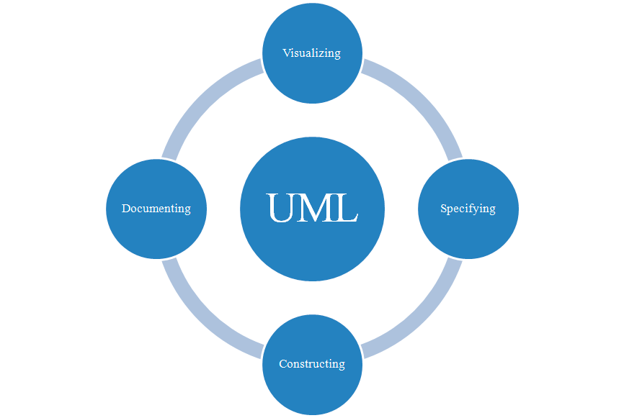
Why UML for modeling?
Use graphical notation to communicate more clearly
Help acquire an overall view of a system.
UML is not dependent on any one language or technology
UML is the language for
Visualizing
Specifying
Constructing
Documenting
…the artifacts of software system.

Slide 21
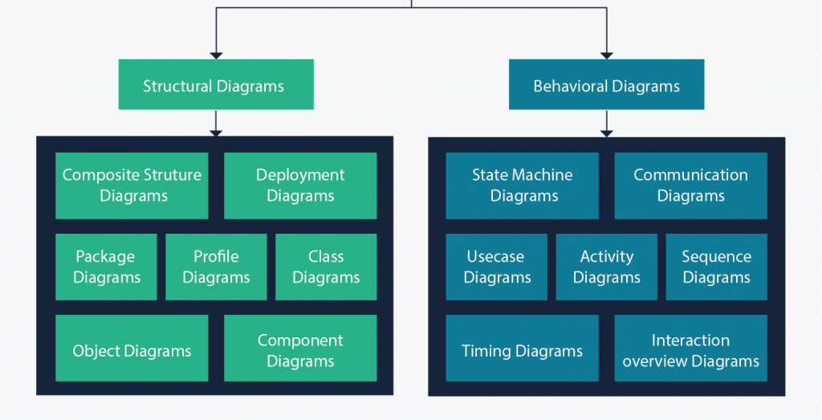

Slide 22
USE CASE DIAGRAMS
Capture functional (behavioral) requirement of the system.

Slide 23
UCD
use case diagrams are used to gather a usage requirement of a system.
They enable you to visualize the different types of roles in a system and how those roles interact with the system
Use case diagram used to model the dynamic behavior (model) of system.
It models how an external entity interacts with the system to make it work.
To identify functions and how roles interact with them – The primary purpose of use case diagrams.
For a high-level view of the system – Especially useful when presenting to managers or stakeholders. You can highlight the roles that interact with the system and the functionality provided by the system without going deep into inner workings of the system.
To identify internal and external factors – This might sound simple but in large complex projects a system can be identified as an external role in another use case.
A use case is a method of capturing requirements for software and system design.
Use cases document the actions of external actors (usually humans, but external systems are also considered actors) interacting with a system to achieve a specific goal.

Slide 24
Components of UCD
Actor
Use case
System
Relationship

Slide 25

UCD
Use case diagrams consist of 4 objects.
Actor
Use case
System
Package
Actor in a use case diagram is any entity that performs a role in one given system. This could be a person, organization or an external system and usually drawn like skeleton shown below.
The actor is an entity that interacts with the system
An actor is someone or something that has a goal in using the system.
Goal: what the actor wants to achieve by interacting with the system.

Slide 26
Primary vs Supporting Actors
The primary actor of a use case is the stakeholder that calls on the system to deliver one of its services. (initiates the use case)
The primary actor is often, the actor who triggers the use case.
A supporting actor (also known as a secondary actor) in a use case in an external actor that provides a service to the system under design. It might be a high-speed printer, a web service, or humans that have to do some research and get back to us.
Use Case Description example:
A user clicks the search button on an application’s user interface. The application sends an SQL query to a database system. The database system responds with a result set. The application formats and displays the result set to the user.

Slide 27
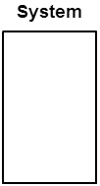
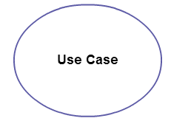
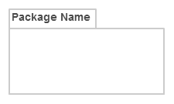
UCD
A use case represents a function or an action within the system. It’s drawn as an oval and named with the function.
A use case is nothing but a core functionality of any working system
The system is used to define the scope of the use case and drawn as a rectangle. This an optional element but useful when you’re visualizing large systems.
The package is another optional element that is extremely useful in complex diagrams. Similar to class diagrams, packages are used to group together use cases. They are drawn like the image shown below.
A use case represents the functionality provided by the system to the user.

Slide 28
ACTORS
Give meaningful business relevant names for actors – For example, if your use case interacts with an outside organization it’s much better to name it with the function rather than the organization name. (Eg: Airline Company is better than PanAir)
Primary actors should be to the left side of the diagram – This enables you to quickly highlight the important roles in the system.
Actors model roles (not positions) – In a hotel both the front office executive and shift manager can make reservations. So something like “Reservation Agent” should be used for actor name to highlight the role.
External systems are actors – If your use case is send-email and if interacts with the email management software then the software is an actor to that particular use case.
Actors don’t interact with other actors
Place inheriting actors below the parent actor

Slide 29
USE CASES
Names begin with a verb
Make the name descriptive – This is to give more information for others who are looking at the diagram. For example “Print Invoice” is better than “Print”.
Highlight the logical order – For example, if you’re analyzing a bank customer typical use cases include open account, deposit and withdraw. Showing them in the logical order makes more sense.
Place included use cases to the right of the invoking use case – This is done to improve readability and add clarity.
Place inheriting use case below parent use case – Again this is done to improve the readability of the diagram.

Slide 30
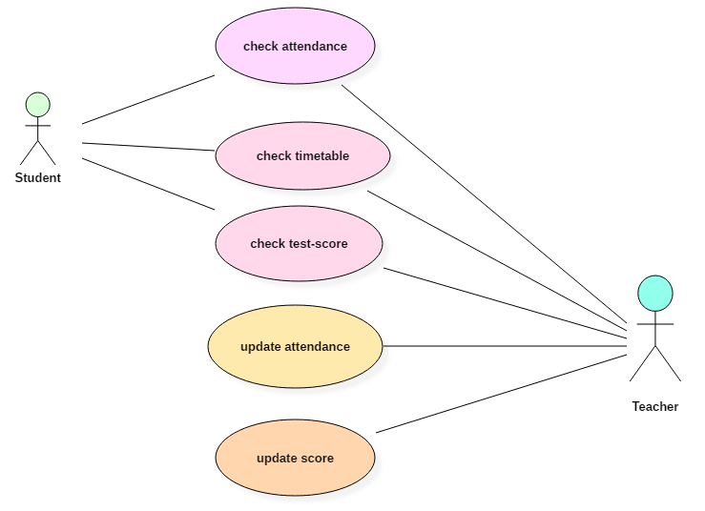
STUDENT MANAGEMENT SYSTEM

Slide 31
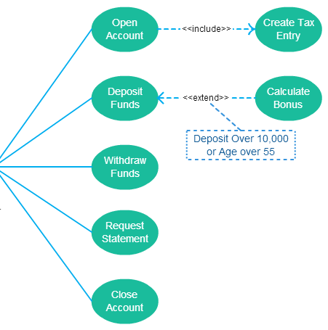
USE CASES

Slide 32
Relationships in use cases
Association between actor and use case
Generalization of an actor
Extend between two use cases
Include between two use cases
Generalization of a use case

Slide 33
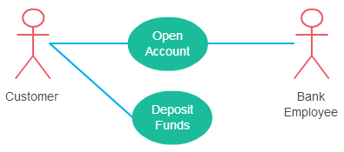
Association Between Actor and Use Case
An actor must be associated with at least one use case.
An actor can be associated with multiple use cases.
Multiple actors can be associated with a single use case.

Slide 34
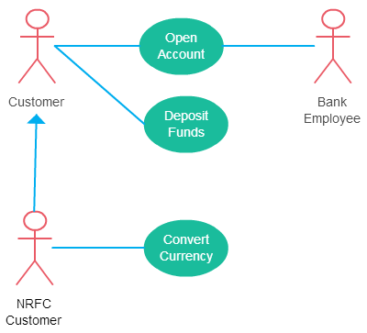
Generalization of an Actor
Generalization of an actor means that one actor can inherit the role of the other actor.
The descendant inherits all the use cases of the ancestor.
The descendant has one or more use cases that are specific to that role.

Slide 35
Extend Relationship Between Two Use Cases
Many people confuse the extend relationship in use cases. As the name implies it extends the base use case and adds more functionality to the system.
The extending use case is dependent on the extended (base) use case. In the below diagram the “Calculate Bonus” use case doesn’t make much sense without the “Deposit Funds” use case.
The extending use case is usually optional and can be triggered conditionally. In the diagram, you can see that the extending use case is triggered only for deposits over 10,000 or when the age is over 55.
The extended (base) use case must be meaningful on its own. This means it should be independent and must not rely on the behavior of the extending use case.
Although extending use case is optional most of the time it is not a must. An extending use case can have non-optional behavior as well.
For example, in an accounting system, one use case might be “Add Account Ledger Entry”. This might have extending use cases “Add Tax Ledger Entry” and “Add Payment Ledger Entry”. These are not optional but depend on the account ledger entry. Also, they have their own specific behavior to be modeled as a separate use case.

Slide 36
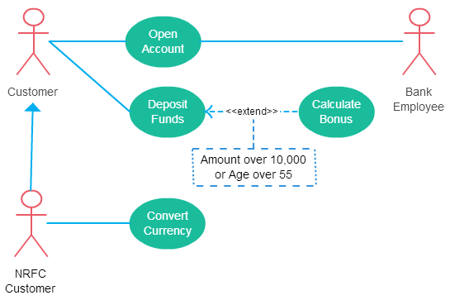
Extend Relationship Between Two Use Cases

Slide 37
Include Relationship Between Two Use Cases
Include relationship show that the behavior of the included use case is part of the including (base) use case.
The main reason for this is to reuse common actions across multiple use cases.
Few things to consider when using the <<include>> relationship.
The base use case is incomplete without the included use case.
The included use case is mandatory and not optional.

Slide 38
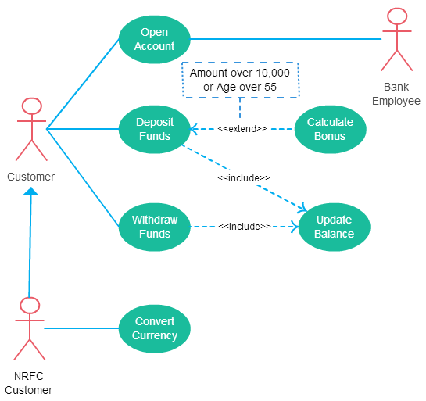
Include Relationship Between Two Use Cases

Slide 39
Generalization of a Use Case
This is similar to the generalization of an actor
The behavior of the ancestor is inherited by the descendant. This is used when there is common behavior between two use cases and also specialized behavior specific to each use case.
For example, in the previous banking example, there might be a use case called “Pay Bills”. This can be generalized to “Pay by Credit Card”, “Pay by Bank Balance” etc.

Slide 40
How to Create a Use Case Diagram
Identifying Actors
Actors are external entities that interact with your system. It can be a person, another system or an organization.
In a banking system, the most obvious actor is the customer. Other actors can be bank employee or cashier depending on the role you’re trying to show in the use case.
An example of an external organization can be the tax authority or the central bank. The loan processor is a good example of an external system associated as an actor.

Slide 41
How to Create a Use Case Diagram
Identifying Use Cases
A good way to identify use cases: what the actors need from the system
In a banking system, a customer will need to open accounts, deposit and withdraw funds, request check books and similar functions. So all of these can be considered as use cases.
Top level use cases should always provide a complete function required by an actor. You can extend or include use cases depending on the complexity of the system.
Look for Common Functionality to use Include
Look for common functionality that can be reused across the system. If you find two or more use cases that share common functionality you can extract the common functions and add it to a separate use case. Then you can connect it via the include relationship to show that it’s always called when the original use case is executed.

Slide 42
How to Create a Use Case Diagram
Is it Possible to Generalize Actors and Use Cases
you can generalize the actor to show the inheritance of functions. You can do a similar thing for use case as well.
One of the best examples of this is “Make Payment” use case in a payment system. You can further generalize it to “Pay by Credit Card”, “Pay by Cash”, “Pay by Check” etc. All of them have the attributes and the functionality of payment with special scenarios unique to them.
Optional Functions or Additional Functions
There are some functions that are triggered optionally. In such cases, you can use the extend relationship and attach an extension rule to it. In the below banking system example “Calculate Bonus” is optional and only triggers when a certain condition is matched.
Extend doesn’t always mean it’s optional. Sometimes the use case connected by extending can supplement the base use case. The thing to remember is that the base use case should be able to perform a function on its own even if the extending use case is not called.

Slide 43
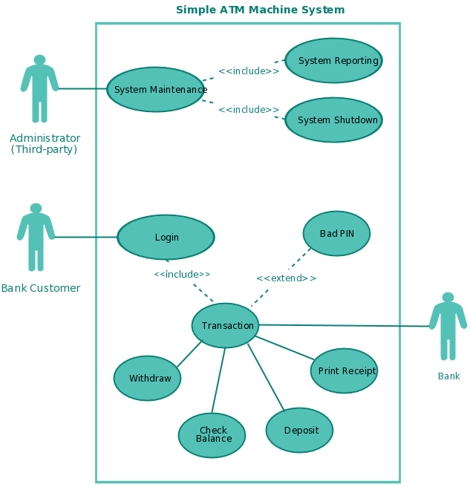
USE CASE DIAGRAM-ATM

Slide 44
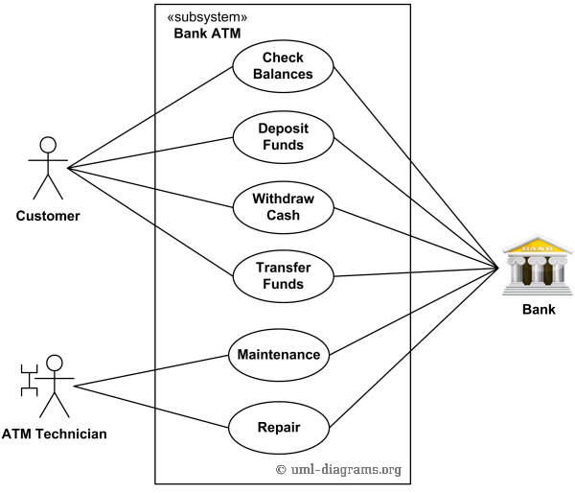
ATM UCD

Slide 45
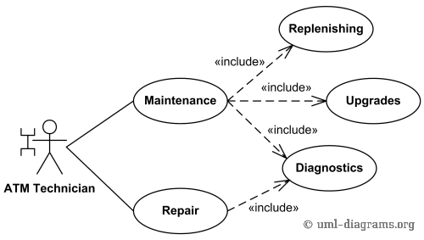
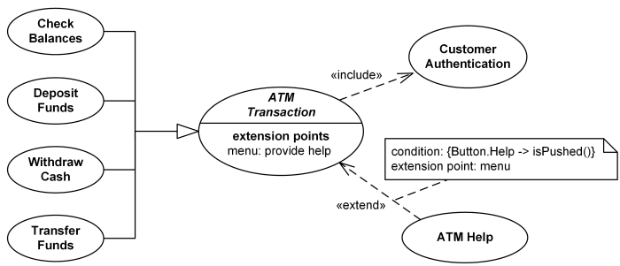

Slide 46
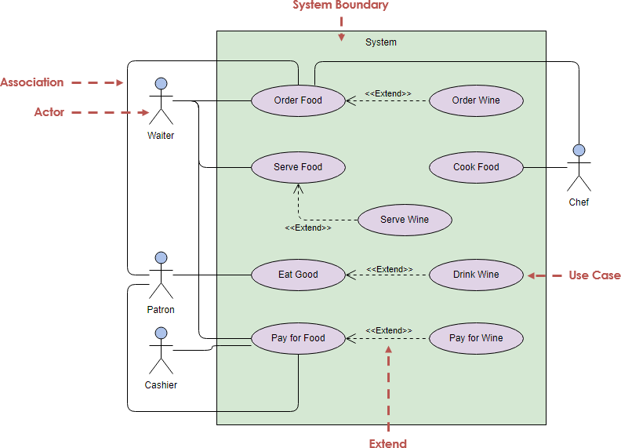

Slide 47
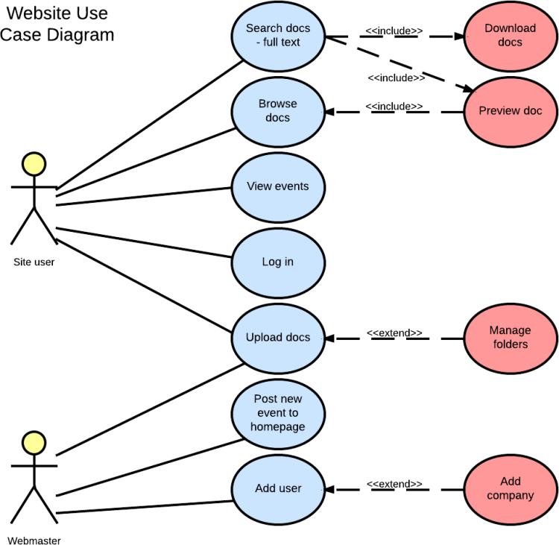
WEBSTE

Slide 48
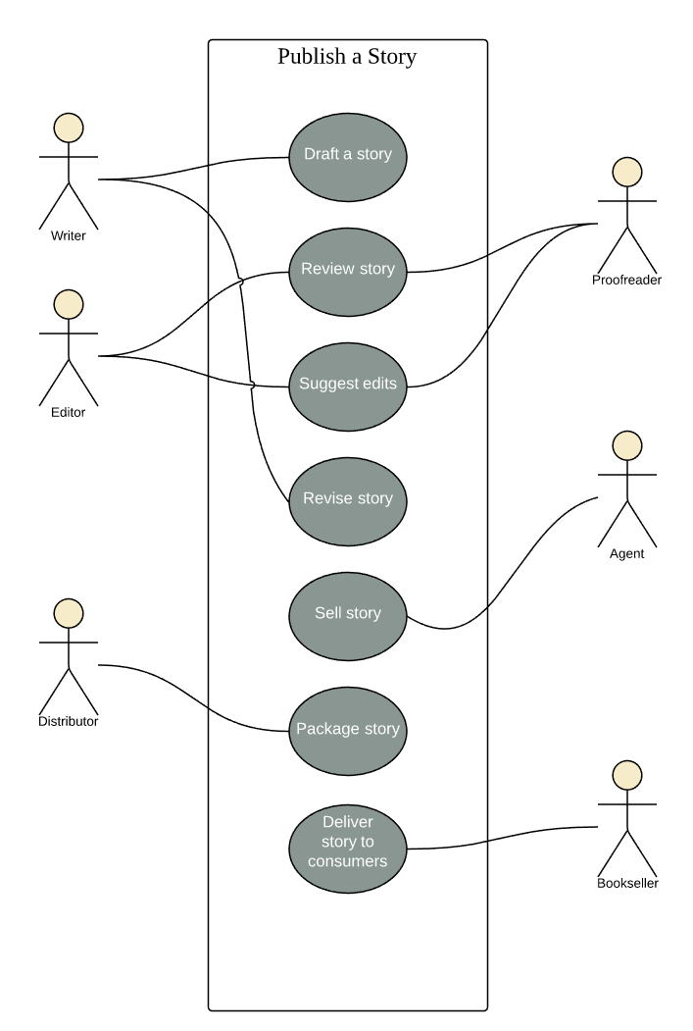

Slide 49
USE CASE Documentation
Purpose?
The use case diagram itself maybe ambiguous.
The diagram on its own does not explain alternative scenarios.
Helps to identify duplicate use case.
Helps to identify contradictory use cases.
It is a good practice to document as you go along.
Helps to list all requirements.

Slide 50
Use case documentation-structure
Title: Name of use case as per use case diagram Brief Description: A summary outlining the purpose of particular use case. Actors: Identify which actor interacts with the use case. Pre-Conditions: ”This use case starts when…”. What is necessary for the use case to start. Flow of Events: This is normal course of events. Post-Conditions: “ This use case terminates when…”. Define the state of the system after the use case ends. Alternative Scenarios: To define exceptional situations. Describe what happens if things go wrong.

Slide 51
Documenting Use Cases – An Example
Title: Order Computer
Brief Description: Allows customer to purchase order
Actor: Customer
Pre- Conditions:
Customer has signed in.
Order entry webpage is displayed
Order item has been selected
Stock details are up to date.

Slide 52
Documenting Use Cases – An Example
Flow of events
Customer selects ‘Buy’ button.
System requests item quantity.
Customer enters item quantity.
System requests delivery details.
Customer enters delivery address.
System accepts details.
System request payment details – includes verify Payment details.

Slide 53
Documenting Use Cases – An Example
Post-conditions:
System generates order number.
Alternative Scenarios
Item not in stock.
Customer not signed in.
Payment not accepted.

